Slide 1

InstructED
Kevin Cao, Andrew Jedlicka, Blake Miller, Shaun Trimm

Slide 2

Completed Features
DASHBOARD
CHAT
LOGIN & REGISTRATION
SUBMISSION
& GRADING
SEARCH
EXTRA FEATURES
Chat with students and instructors, both privately and in groups
Secure login with unique ID, Duo authentication, and password recovery
View announcements and upcoming assignments with due dates
File upload for students & instructors. Administrators can approve course files
Search for assignments, files, & announcements. Admins can search courses and users
Toggleable global dark-mode. Instructors can view average grades for assignments

Slide 3
Technology
FRONT-END
BACK-END
React, Material UI, Bootstrap, Axios
ExpressJS, Socket.IO, PostgreSQL, Heroku,
AWS S3, DuoLogin

Slide 4
Sprint Responsibilities
SPRINT 1
SPRINT 3
SPRINT 5
Login
& Registration
Kevin: Backend
Blake: Backend
Andrew: Frontend
Shaun: Backend
SPRINT 2
Submissions
& Grading
Kevin: Backend
Blake: Backend
Andrew: Frontend
Shaun: Frontend
SPRINT 5
Chat &
Extra Features
Kevin: Frontend
Blake: Frontend
Andrew: Frontend
Shaun: Backend
Dashboard
Kevin: Backend
Blake: Backend
Andrew: Frontend
Shaun: Frontend
Search
Kevin: Backend
Blake: Frontend
Andrew: Frontend
Shaun: Backend

Slide 5
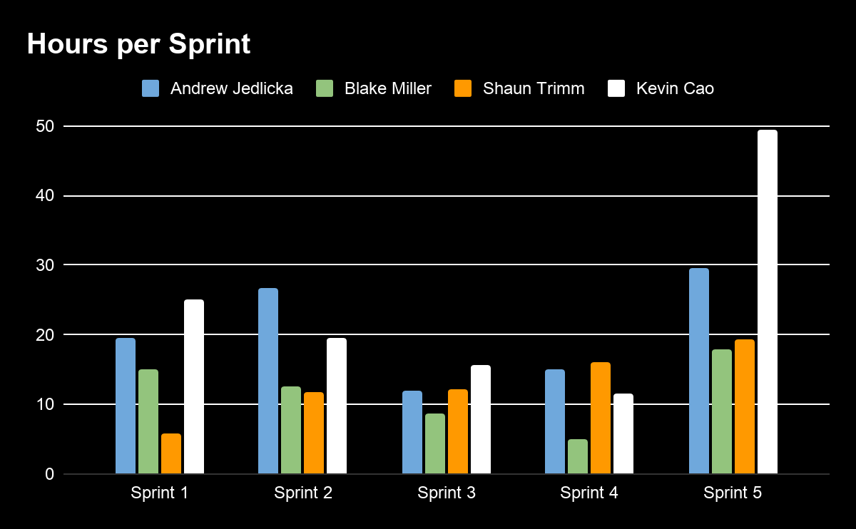
Contributions per Sprint

Slide 6

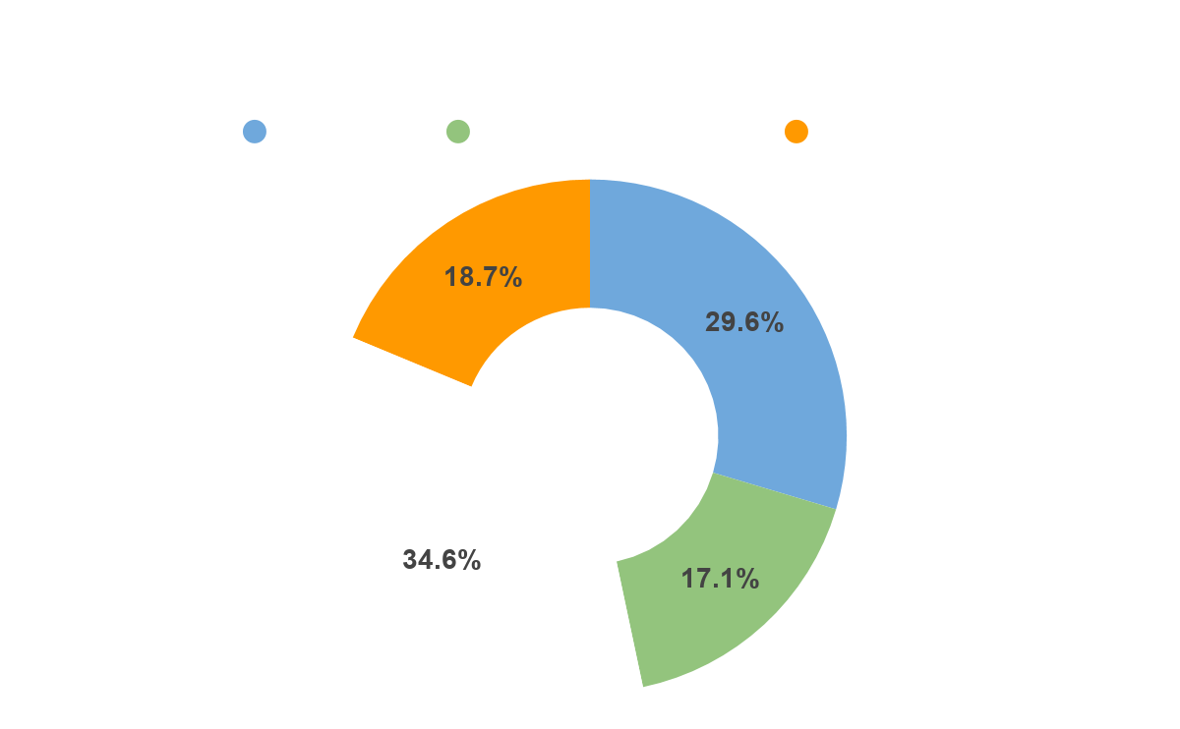
Total Contributions

Slide 7
DEMO

Slide 8
Obstacles and Issues
Unfamiliar
Tech Stack
This was the first experience in web development for most of the members.
Architecture and Scalability
Due to lack of experience with ReactJS, frontend architecture was not as scalable as would have liked.
Mercury is the closest planet to the Sun

Slide 9
Future Improvements
IMPROVED UI
ASSIGNMENTS
NOTIFICATIONS
COLOR SCHEMES
More aesthetically pleasing UI, especially for the dashboard
Additional assignment types such as in-browser quizzes and exams
Notification system that sends emails for nearly-due assignments or newly-submitted grades
Custom color schemes for each user and each course, with additional support for dark mode

Slide 10
LINKS
Webapp
https://instructed.herokuapp.com/
Github
https://github.com/defCoding/instructEd
JIRA
https://test.uisapp2.iu.edu/jira-stg/projects/P565F19P1/summary

Slide 11
Thank you for listening!

